Slide 1
Mushroom Edibility Analysis
Kyle Cheng
500627248
Supervisor: Tamer Abdou

Slide 2
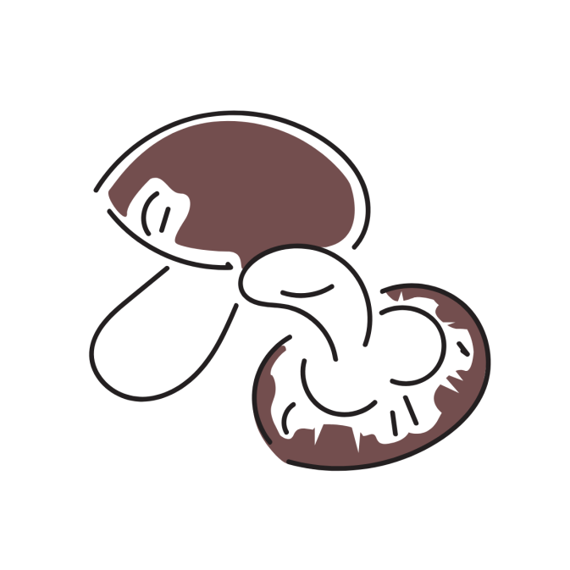
Importance of Mushrooms
Source of food
Cultural practices
Poisonous vs. edible

Slide 3

Project Goals
Theme:
Classification of toxic and non-toxic mushrooms
To Determine:
Key characteristics
Specific patterns or combinations of features
Geographic differences
Can machine learning or AI assist in automated identification

Slide 4
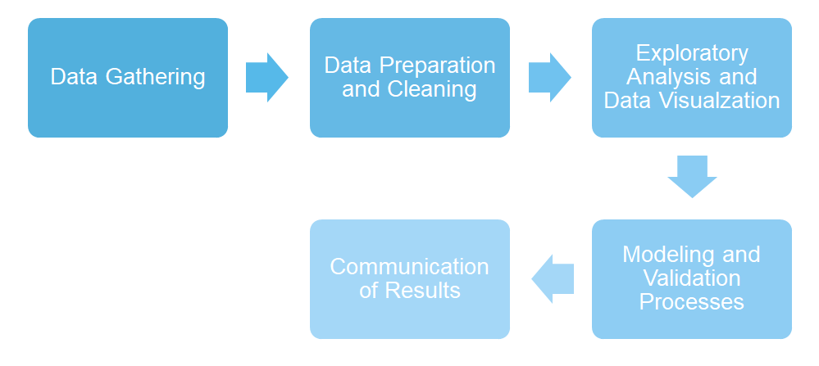
Milestones and Project Approach
Abstract
Literature Review
Exploratory Data Analysis (EDA)
Initial/Model Results
Evaluation
Final Results

Slide 5

Milestones and Project Approach Cont.
Post-Literature Review Fixes:
Added the EDA + clarification of the cleaning of dataset
Added techniques to obtain influential predictors
Added the random forest classifier to list of potential models
Post-Initial Code Fixes:
Restructured the readme file
Added descriptions to the visual aid of data

Slide 6

Literature Review Summary
Alkronz et al. (2019)
Viability exists in predictive modeling
Uses a slightly different dataset, similar features
Uses a different predictive model (BPNN)
Ottom et al. (2019)
Random forest model is promising
Uses a different dataset, different features
Gill size is the most prominent feature (closest feature is gill spacing)
Existing Studies:
Alkronz, E. S., Moghayer, K. A., Meimeh, M., Gazzaz, M., Abu-Nasser, B. S., & Abu-Nasser, S.S. (2019, February). Prediction of whether mushroom is edible or poisonous using back-propagation Neural Network. International Journal of Academic and Applied Research.
Ottom, M. A., Alawad, N. A., & Nahar, K. M. O. (2019). Classification of mushroom fungi using machine learning techniques. International International Journal of Advanced Trends in Computer Science and Engineering.

Slide 7
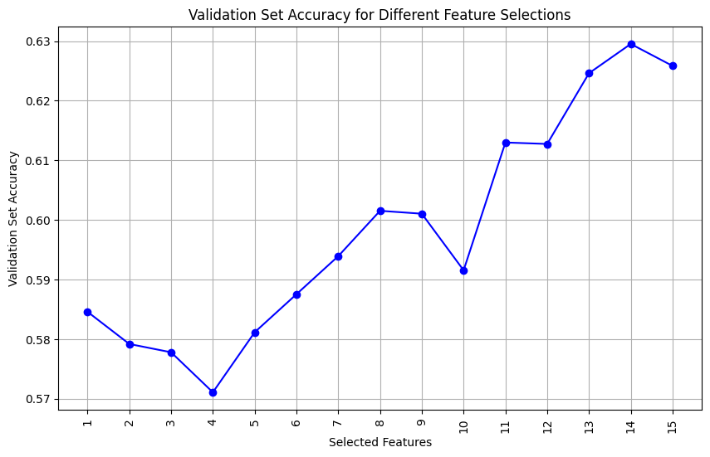
EDA Summary
Data Types
Assigned categorical variables to numeric ones
Influential Predictors
Correlation matrix
No strong correlations
Forward Selection
More features increased accuracy

Slide 8
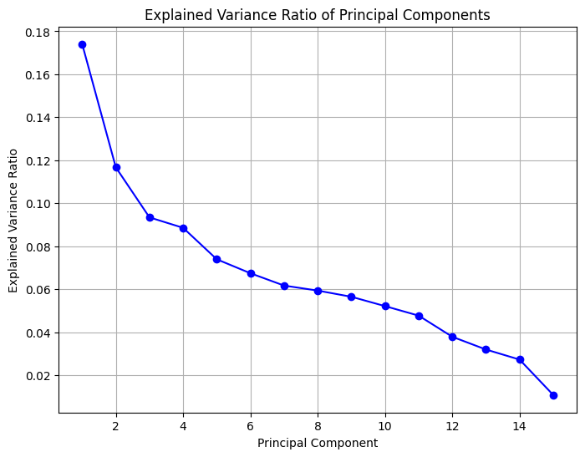
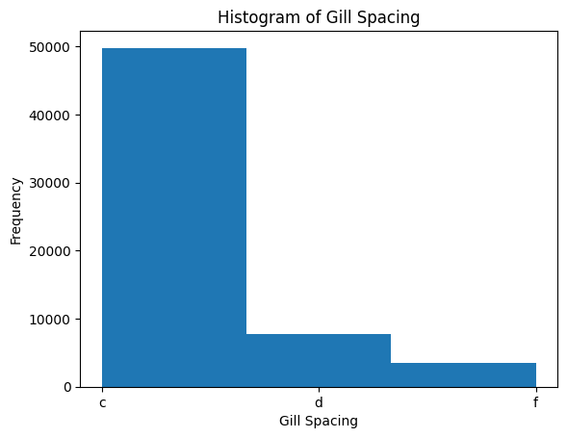
EDA Summary Cont.
PCA
Data Visualization

Slide 9
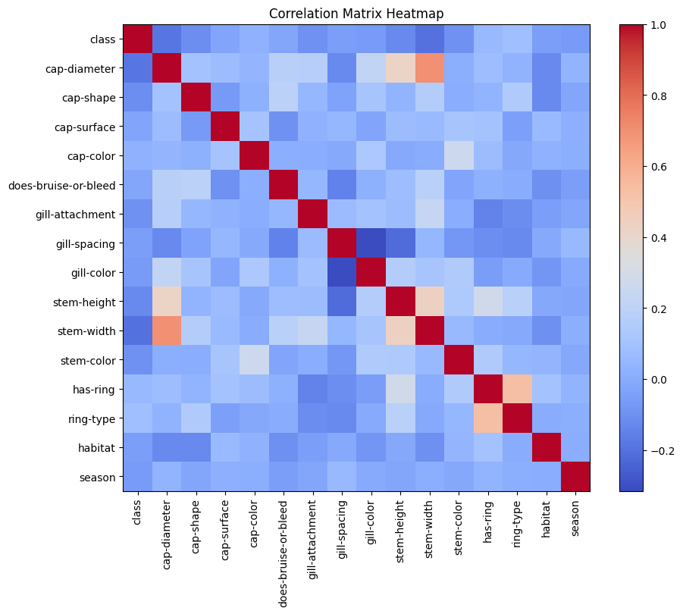
EDA Summary Cont.
Data Visualization

Slide 10

Tools
Logistic Regression
Naïve Bayes
Decision Tree
Random Forest

Slide 11
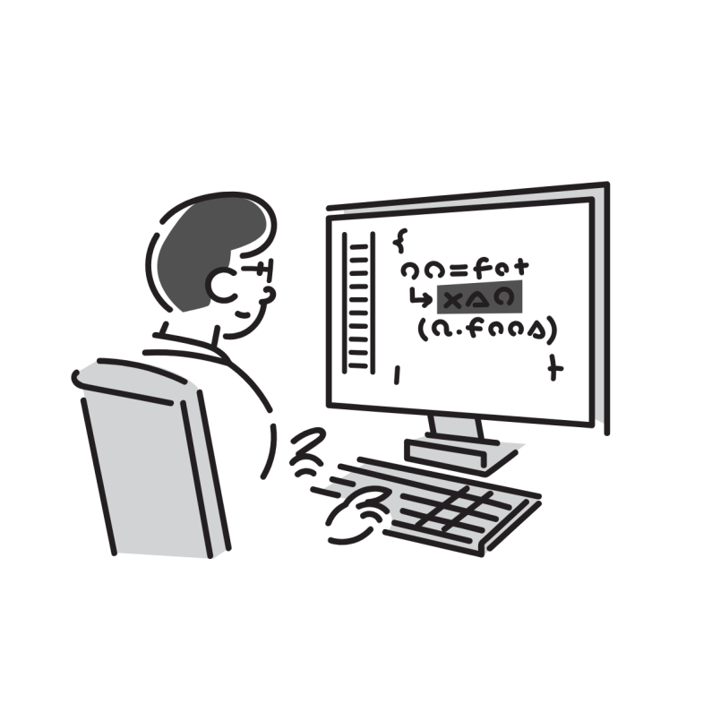
Results of Model Testing
Test/Train Split
Accuracy Results:
1. Random Forest: 99.98%
2. Decision Tree: 99.61%
3. Logistic Regression: 62.71%
4 .Naïve Bayes: 59.20%

Slide 12

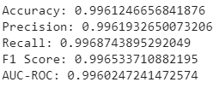
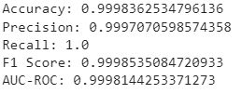
Results of Model Testing Cont.
Decision Tree
Random Forest

Slide 13
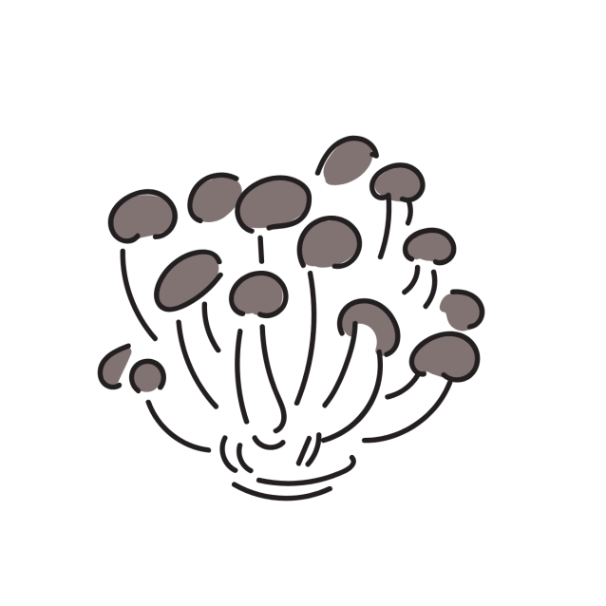
Finding #1: Key Features
What are the key characteristics that differentiate a toxic mushroom from a non-toxic one?
Top 3 Features:
Stem Height (0.1446)
Cap Shape (0.0938)
Gill Color (0.0931)

Slide 14
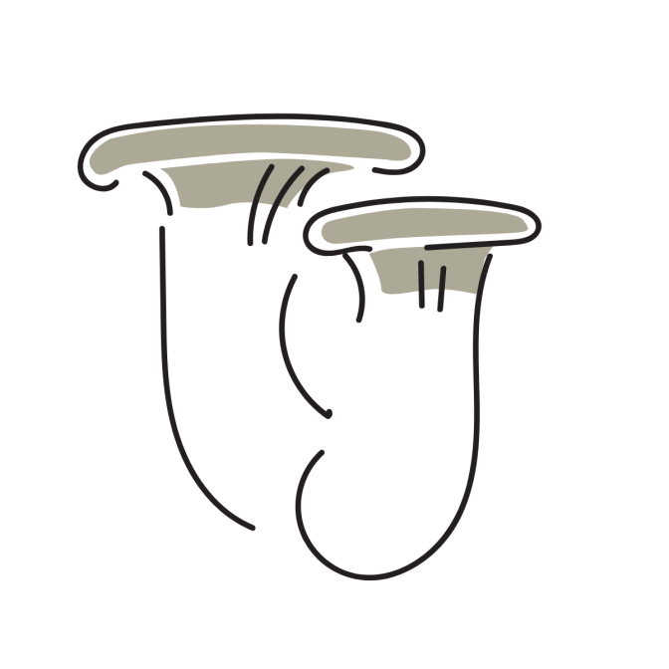
Finding #1: Key Features cont.
Full List
Stem Height (0.1446)
Cap Shape (0.0938)
Gill Color (0.0931)
Stem Width (0.0862)
Gill Spacing (0.0858)
Bruise or Bleed (0.0856)
Cap Surface (0.0609)
Cap Diameter (0.0591)
Gill Attachment (0.0502)
Has Ring (0.0481)
Cap Color (0.0352)
Ring Type (0.0335)
Stem Color (0.0261)
Habitat (0.0149)

Slide 15

Finding #2: Patterns and Combinations
Are there specific patterns or variations that serve as strong indicators of mushroom toxicity?
Top 3 Combination of Features:
Cap Surface, Stem Height, Stem Width
Cap Surface, Gill Color, Stem Width
Cap Surface, Gill Attachment, Stem Width

Slide 16

Finding #3: Geographic Features
Are there geographic features that can be incorporated into identification protocols?
Results:
Habitat (0.0149)
Low Importance
1/15 Locational Features

Slide 17

Finding #4: Model Applicability
Can machine learning or AI algorithms assist in the automated identification of toxic mushrooms?
Results:
Performance is good
Can be seen as viable
Needs stability test

Slide 18

Summary of Findings
Finding #1: The most important features are stem height, cap shape, gill color
Finding #2: Important combination of features is the cap surface, stem height and stem width
Finding #3: There are no geographic indicators of mushroom edibility

Slide 19

Summary of Findings Cont.
Finding #4: There is viability in using classifier models to discern between toxic and non-toxic mushrooms

Slide 20

Noting of Setbacks
Efficiency of finding the patterns low
Need additional primary data
Stability not considered

Slide 21
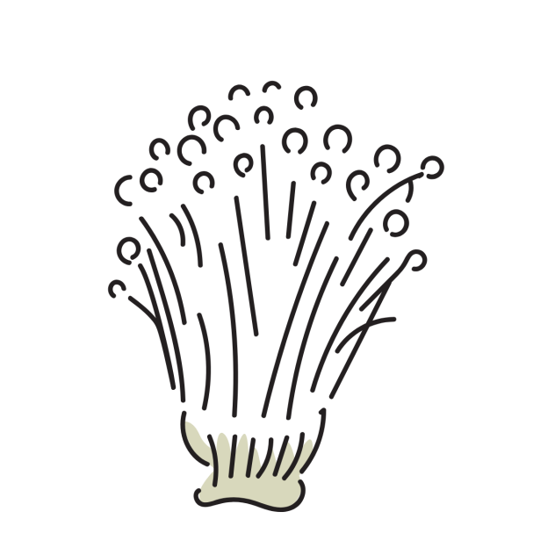
Future Endeavors
More time = more features
Gather more primary data
Utilize a k-fold stability test

Slide 22
Thanks for your time!

